Slide 1



Introduction to Artificial Intelligence – Day 1
Shier Nee Saw, PhD
Department of Artificial Intelligence,
Faculty of Computer Science and Information Technology,
Universiti Malaya
sawsn@um.edu.my
https://shiernee.com

Slide 2

Machine Learning
Artificial Intelligence
A technique which enables machines to mimic human behaviour
Artificial Intelligence
Machine Learning
Machine Learning
Subset of AI technique which uses statistical methods to enable machines to improve with experience.
Deep Learning
Deep Learning
Subset of Machine Learning which make the computation of multi-layer neural network feasible

Slide 3
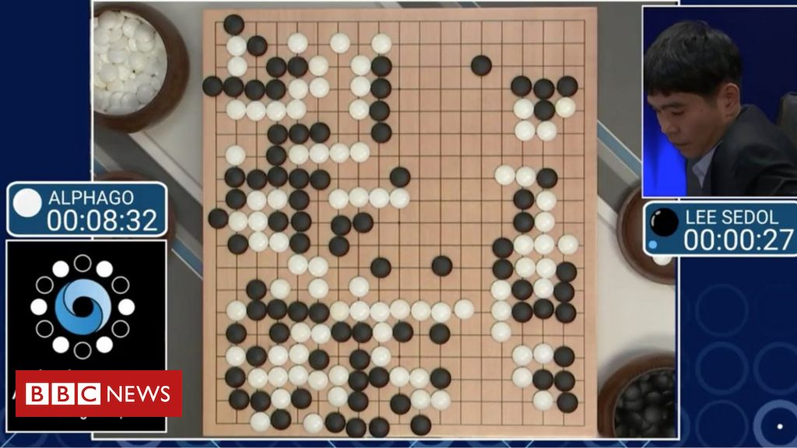
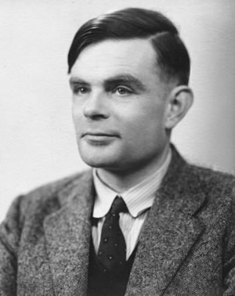
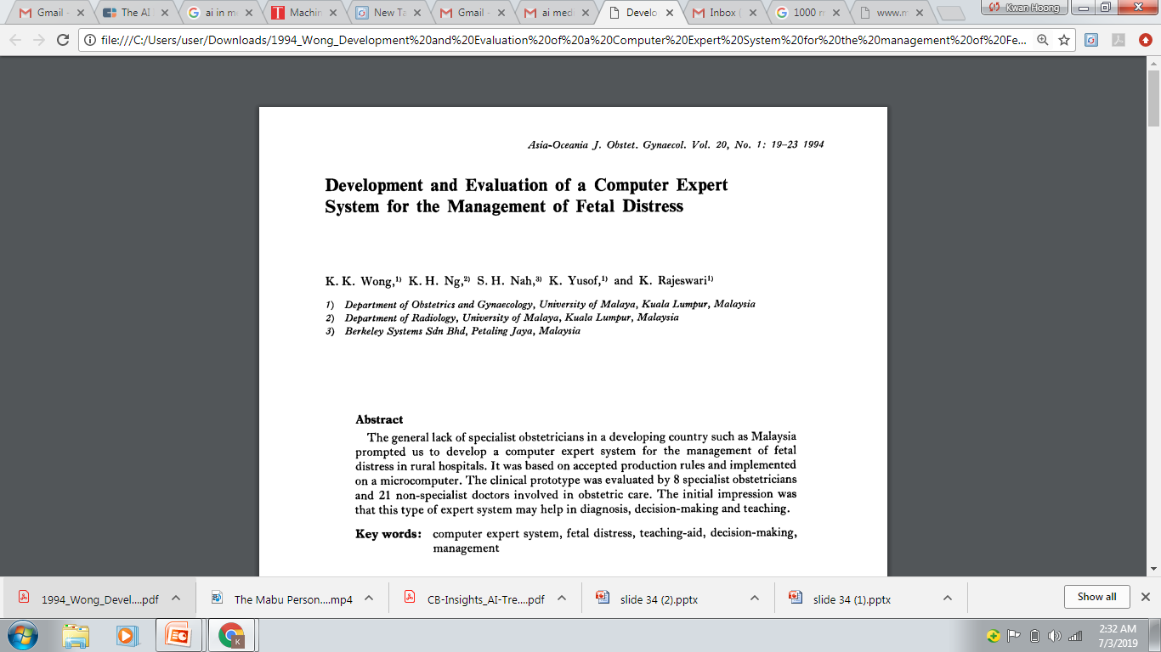
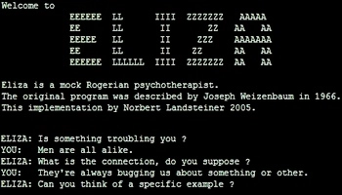
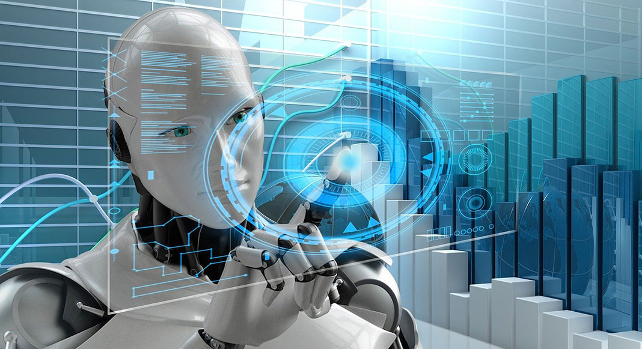
History
“Can machines think?”
Alan Turing introduce a method for machine intelligence
First AI Winter
Second AI Winter
Alpha Go defeated Lee Sedol, world champion of Go
https://www.bbc.com/news/technology-35785875
https://editions.covecollective.org/chronologies/alan-turing-%E2%80%9Ccomputing-machinery-and-intelligence%E2%80%9D-1950
1950
1966
1975
1980
1987
2016
Now
First Chatbot: ELIZA
Expert System
AI in everywhere
https://www.computerhope.com/jargon/e/eliza.htm
Notes:
The history of AI starts very early. In 1950s, at the dawn of computing, Alan Turing asked the question: "Can machines think?“ and he then introduced a method to test machine intelligence. This was at a time when the first general purpose computers had only just been built. In 1966, the first chatbox – ELIZA was built. Unfortunately, AI entered the first winter in 1975 where not much people were interested in such topics and no fundings were available to support this research. In 1980, it started to gain attraction again where expert system were built. In fact, UM also involved in this where they had developed a computer expert system to manage fetal distress. In 1987, AI entered the second winter again because the system was too difficult to maintain, to update and was unable to learn. Until 2016, Alpha GO was announced to defeat Lee Sedol, the world champion of GO. This shows the world how powerful a computer can be. And then, now AI in everywhere, be it in automotive, manufacturing or healthcare.

Slide 4
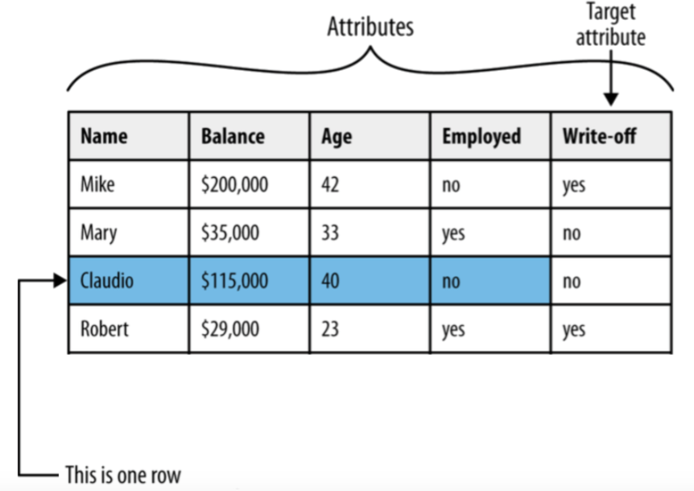
Dataset Terminology

Slide 5
Dataset Terminology
The following terms are used interchangeably:
Row, observation, datapoint
Column, attribute, feature
Target attribute, target, label
A target attribute is one we are interested in predicting

Slide 6
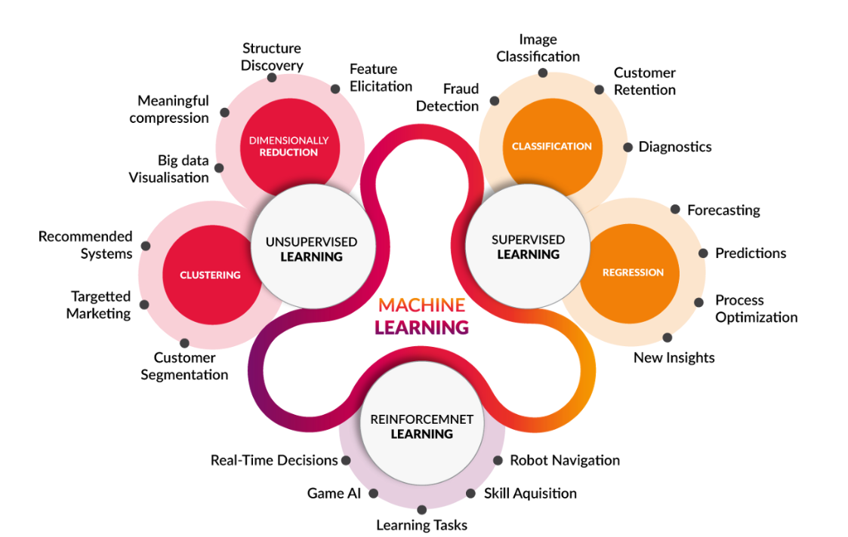
Machine Learning
https://medium.com/@yadavdeepika729/different-machine-learning-models-2387575e64cd

Slide 7
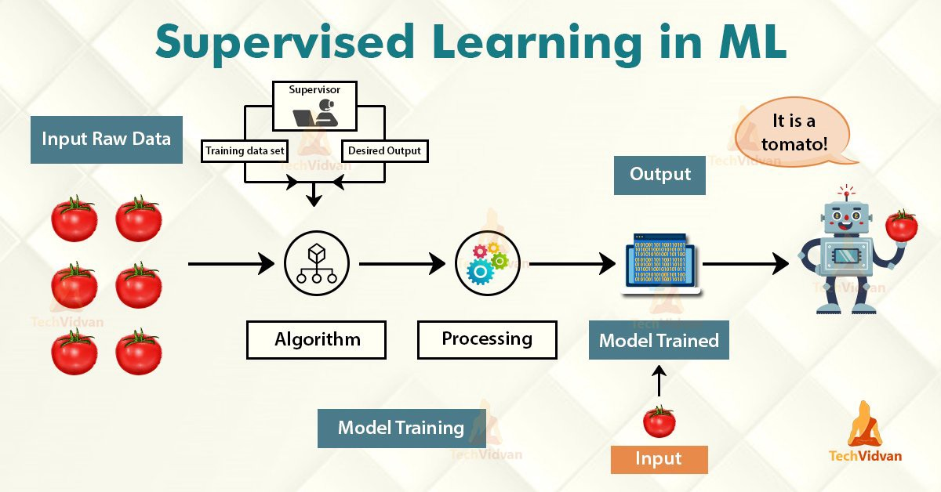
Machine Learning
Have Label
Learn from data pattern
https://medium.com/@yadavdeepika729/different-machine-learning-models-2387575e64cd

Slide 8
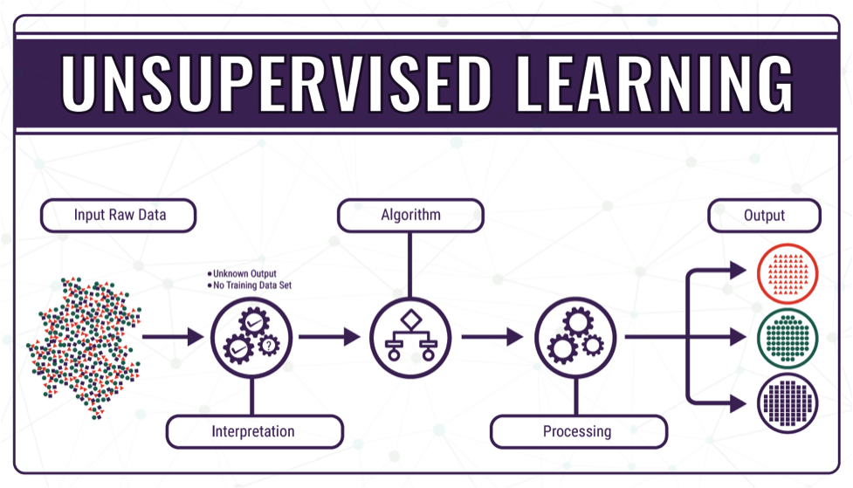
Machine Learning
Do not have label
Group similar data together
https://medium.com/@yadavdeepika729/different-machine-learning-models-2387575e64cd

Slide 9
Machine Learning
https://medium.com/@yadavdeepika729/different-machine-learning-models-2387575e64cd

Slide 10

Classification
Pause and think about some possible example on classification problem.
https://www.springboard.com/blog/data-science/regression-vs-classification/
Notes:
Before go into Machine Learning, we learn on the terminology first.

Slide 11
Classification
Classification is used when the target attribute is a category
Model is built based on target attributes of historical data
Examples: – Predicting churn – Predicting write-off
Notes:
Before go into Machine Learning, we learn on the terminology first.

Slide 12
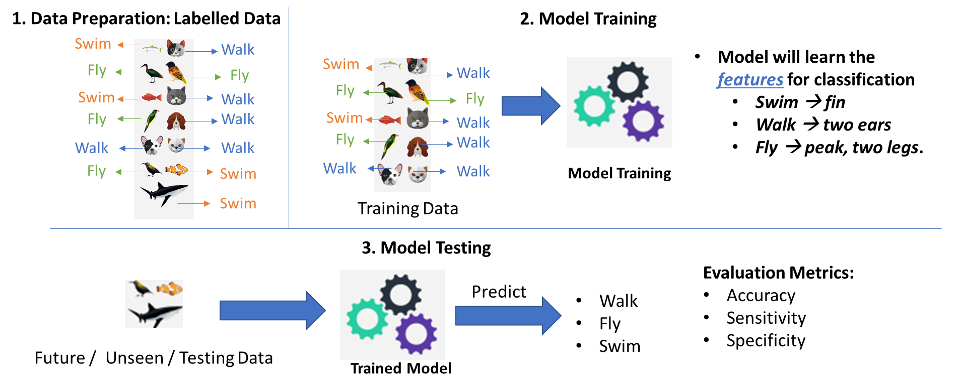
Classification – Developing ML model

Slide 13
Classification – Developing ML model
Data Preparation
Data Splitting (Train/Test)
Model Training
Model Evaluation
Data | Feature1 | Feature2 | Prediction | Label
Data1 | 23 | 3 |  | Cold
Data2 | 12 | 51 |  | Hot
Data3 | 1 | 12 |  | Hot
… | … | … |  | …
DataN | 15 | 65 |  | Cold

Slide 14
Classification – Developing ML model
Data Preparation
Data Splitting (Train/Test)
Model Training
Model Evaluation
Data | Feature1 | Feature2 | Prediction | Label
Data1 | 23 | 3 |  | Cold
Data2 | 12 | 51 |  | Hot
Data3 | 1 | 12 |  | Hot
… | … | … |  | …
DataN | 15 | 65 |  | Cold
70%
Training
30%
Test

Slide 15
Classification – Developing ML model
Data Preparation
Data Splitting (Train/Test)
Model Training
Model Evaluation
Use only training data to train the model
Data | Feature1 | Feature2 | Prediction | Label
Data1 | 23 | 3 |  | Cold
Data2 | 12 | 51 |  | Hot
Data3 | 1 | 12 |  | Hot
… | … | … |  | …
DataN | 15 | 65 |  | Cold
70%
Training

Slide 16
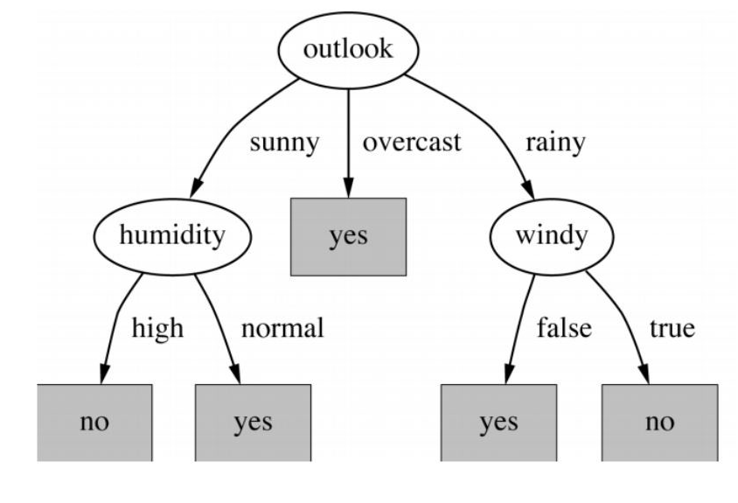
Classification – Developing ML model
Data Preparation
Data Splitting (Train/Test)
Model Training
Model Evaluation
Example of decision tree

Slide 17
ML Model – Classifiers Evaluation Metrics
Data Preparation
Data Splitting (Train/Test)
Model Training
Model Evaluation
Use only testing data to evaluate the model
Data | Feature1 | Feature2 | Prediction | Label
Data1 | 23 | 3 | Cold | Cold
Data2 | 12 | 51 | Cold | Hot
Data3 | 1 | 12 | Hot | Hot
… | … | … | … | …
DataN | 15 | 65 | Hot | Cold
30%
Test
https://en.wikipedia.org/wiki/Confusion_matrix

Slide 18
ML Model – Classifiers Evaluation Metrics
Data Preparation
Data Splitting (Train/Test)
Model Training
Model Evaluation
A perfect model should predict all testing data correctly → Accuracy = 100%
Data | Feature1 | Feature2 | Prediction | Label
Data1 | 23 | 3 | Cold | Cold
Data2 | 12 | 51 | Cold | Hot
Data3 | 1 | 12 | Hot | Hot
… | … | … | … | …
DataN | 15 | 65 | Hot | Cold
30%
Test
https://en.wikipedia.org/wiki/Confusion_matrix

Slide 19
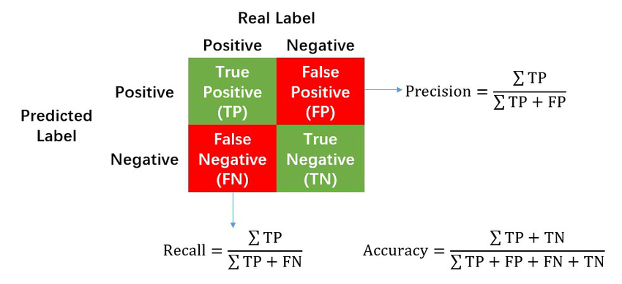
ML Model – Classifiers Evaluation Metrics
Data Preparation
Data Splitting (Train/Test)
Model Training
Model Evaluation
Confusion Matrix
https://en.wikipedia.org/wiki/Confusion_matrix

Slide 20
ML Model – Classifiers Evaluation Metrics
Accuracy: How many % of predicted cases are correct.
Precision: How many % of predicted positive cases are actually positive
Recall: How many % of positive cases did the classifier predict as positive?
F measure (F₁ or F-score): harmonic mean of precision and recall.
Perfect score is 1.0

Slide 21
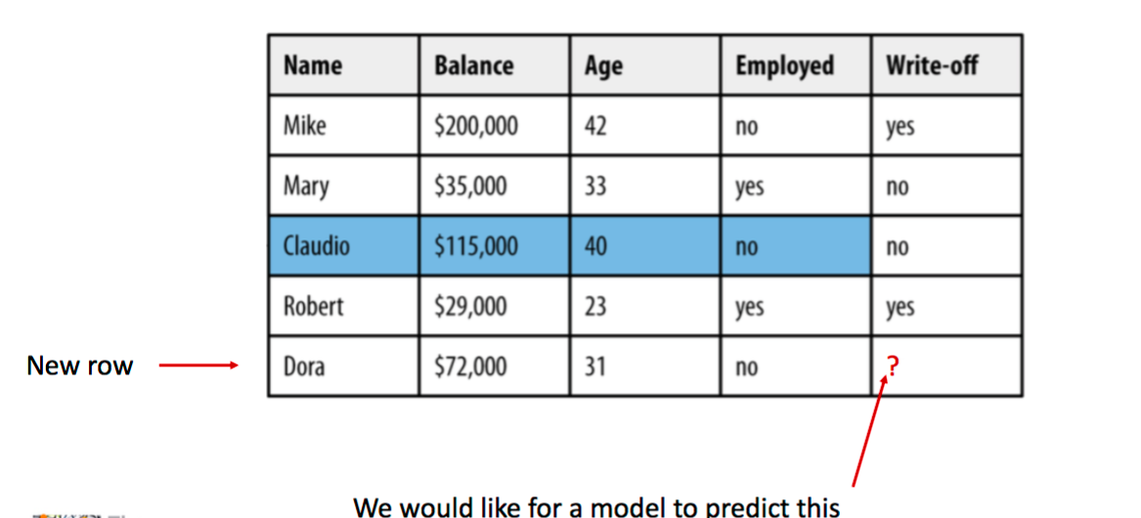
Classification - Example

Slide 22
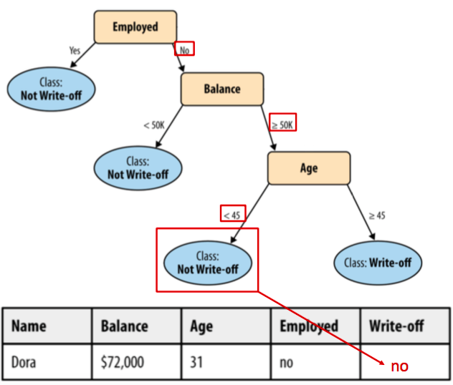
Classification – Decision Tree

Slide 23
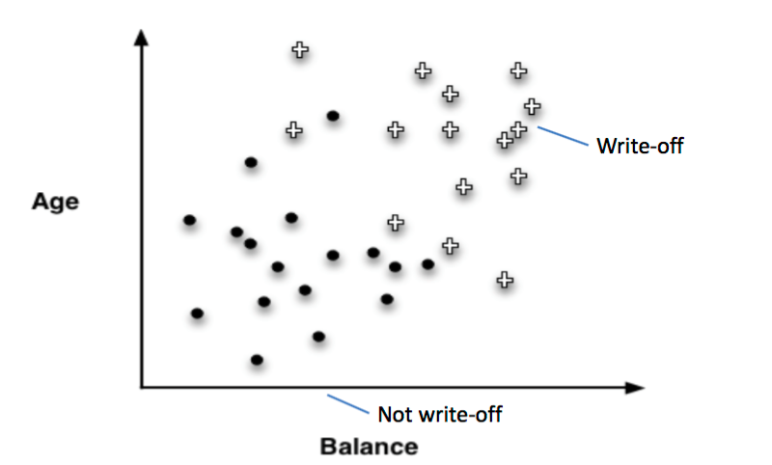
Classification – Results Visualization

Slide 24
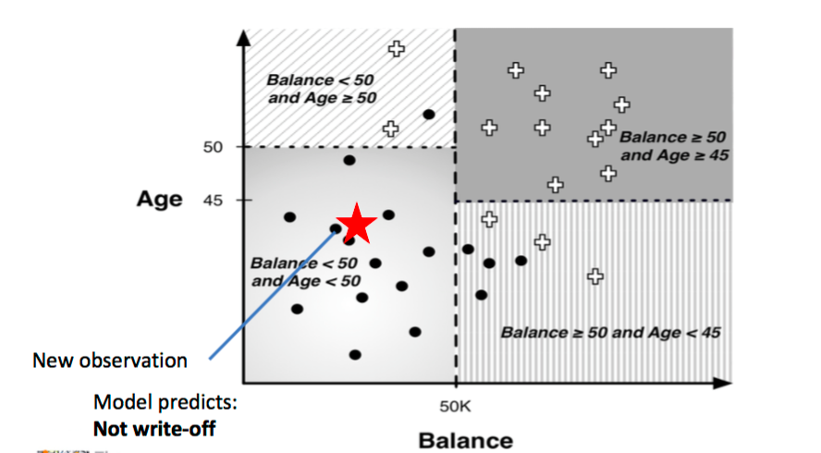
Classification – Results Visualization

Slide 25
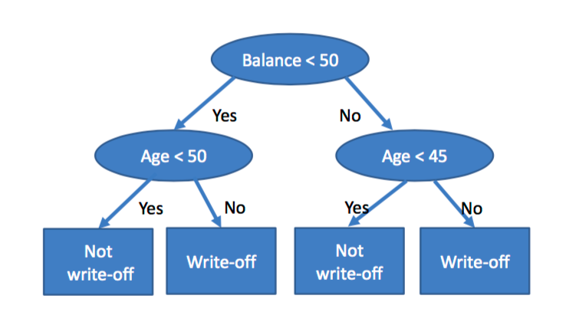
Corresponding Decision Tree

Slide 26
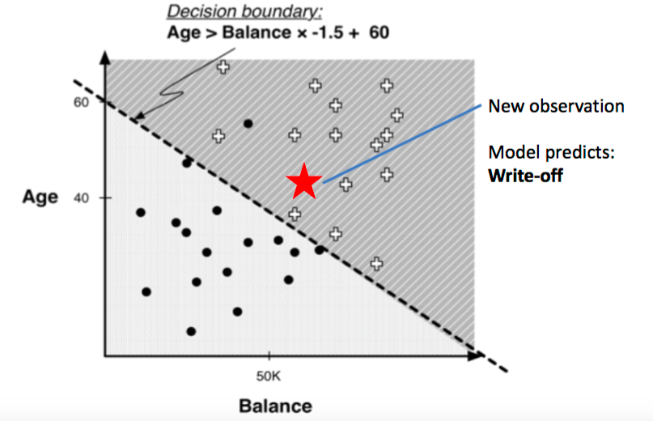
Results Visualization – Linear Classifier

Slide 27
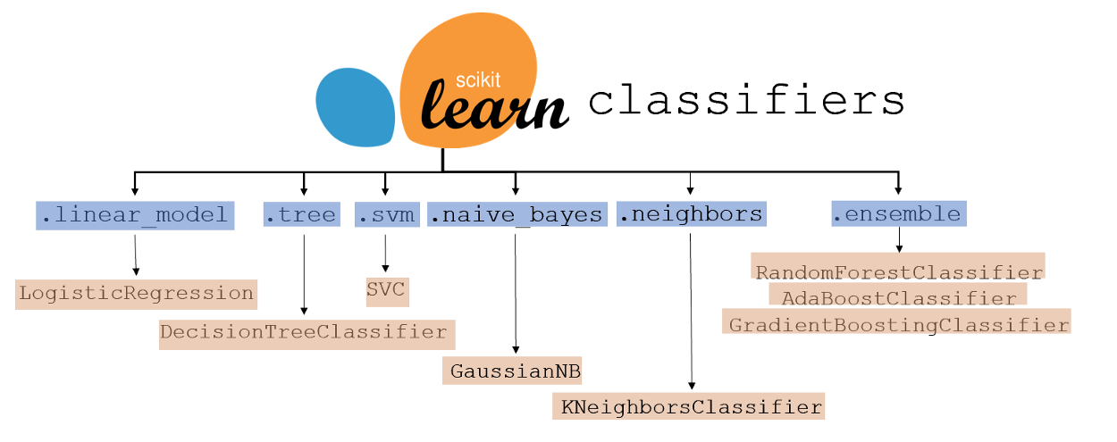
ML Model – Other types of classifiers
https://www.kdnuggets.com/2021/01/ultimate-scikit-learn-machine-learning-cheatsheet.html

Slide 28
Corresponding Code
Data Preparation
Data Splitting (Train/Test)
Model Training
Model Evaluation
pd.read_csv()
sklearn.model_selection.train_test_split()
model.fit()
model.predict()

Slide 29
Additional Reading
Your First Machine Learning Project in Python Step-By-Step https://machinelearningmastery.com/machine-learning-in-python-step-by-step/
4 Types of Classification Tasks in Machine Learning https://machinelearningmastery.com/types-of-classification-in-machine-learning/
Machine Learning Classifiers https://towardsdatascience.com/machine-learning-classifiers-a5cc4e1b0623
Save and Load Machine Learning Models in Python with scikit-learn https://machinelearningmastery.com/save-load-machine-learning-models-python-scikit-learn/

